Slide 1

Natural Language Processing
Taylor Kramer and Anne Moshyedi
Chief Innovation Lab Interns
SWIFT | Strategic Architecture | Innovation
August 7, 2018
Notes:
NLP
Name
School
Majors
Interest in ML

Slide 2
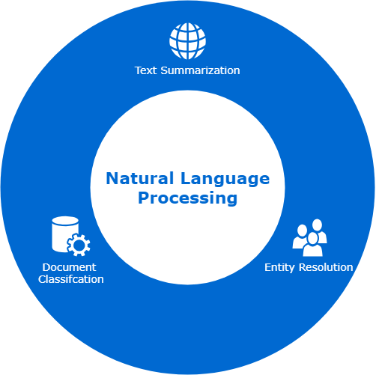
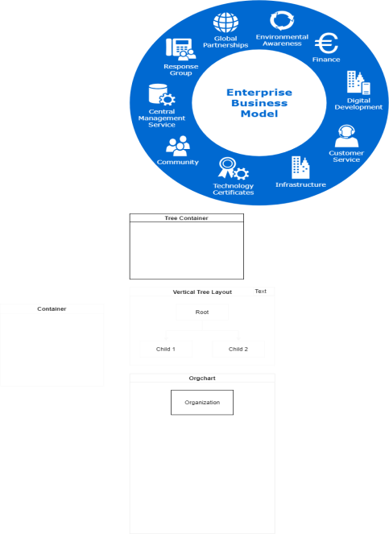
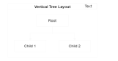
Natural Language Processing
Summarize
This document
For people
to read
Notes:
Define NLP w/i ML
- Branch of AI
- Helps computers understand human language
- Draws from CS and computational linguistics to bridge the gap between human communication and computer understanding
NLP Applications
Interest in NLP: new emerging field with many applications in wide variety of industries

Slide 3
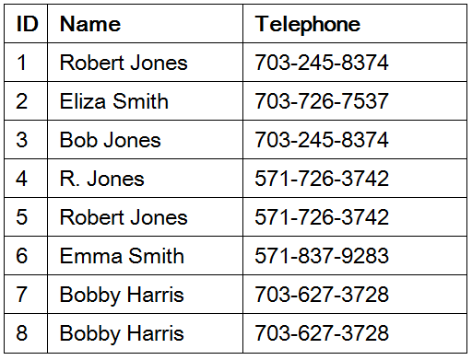
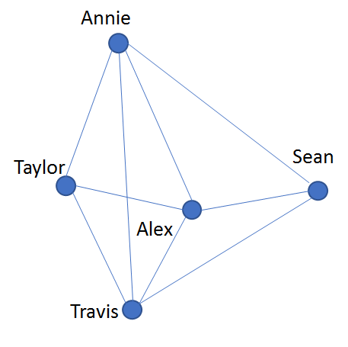
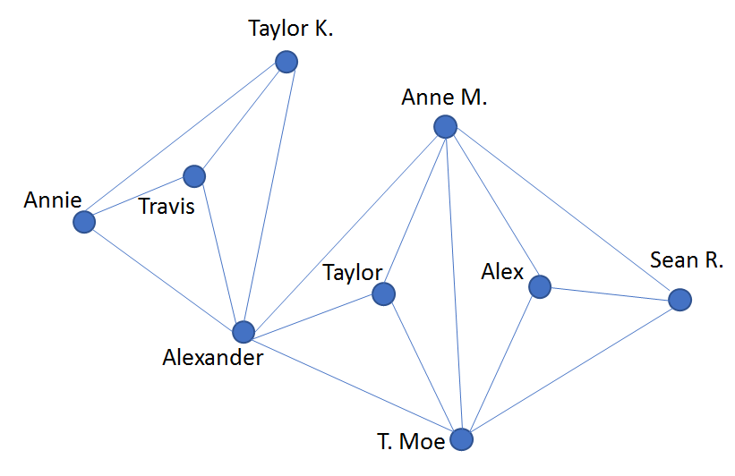
Entity Resolution
Before
After
Notes:
The NLP problem that we tackled first was
Define
Disambiguating real world entities from various records by linking and grouping similar entities
example 1
example 2
Entities refered to in diff ways
Network of collab prior to ER

Slide 4
Possible Entity Resolution Use Cases Within SWIFT
Consolidating Datasets Across Departments
Matching User Entries Against a Known Dictionary
Vendor Product List Management
Extracting Big Picture Transaction Data
Linking Records Across Datasets

Slide 5
Our Specific Use Case and Added Business Value
Resolving Bank Address Ambiguities with Entity Resolution
How can we match misspelled user input to known dictionary records?
What is the problem, magnitude, where, why?
Why now? What are the consequences, priority ?
What are the expected benefits ?
Erroneous user entries in SWIFT portals are not matched exact to list of acceptable addresses
Current method of resolving this issue slows down the speed of transaction, and is cumbersome for the user and SWIFT
User may accidentally transfer money to an unintended address without a method of address confirmation. A solution would limit false positive recommendations
Entity Resolution is an emerging field containing new solutions to a wide variety of issues
Solving this use case will lead to more knowledge about solutions to other related inefficiencies within SWIFT
Current experts in the field are willing and able to share their expertise with those interested
SWIFT benefit
Adding value to the developing SWIFT NLP Platform
Save frustration and time for users with our system
Ensure teams have comprehensive data of what they need
Limit size of data in the case of duplicates to increase efficiency
Increase general SWIFT employee knowledge of emerging technologies and fields
Intern benefit
Hands-on experience with new technologies
Opportunity to address a real business problem and provide value to SWIFT
Opportunity to interact with experts
5

Slide 6
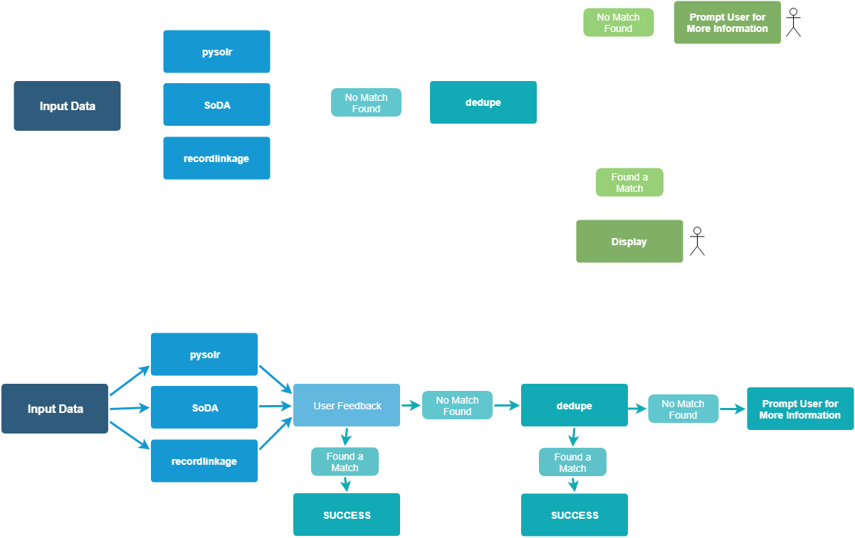

Entity Resolution Workflow
Preliminary
Look Up
ML Model
Output
Input
Notes:
PySolr
Python wrapper which allows us to query Solr index
SoDA (Solr Dictionary Annotator)
Wrapper used with SolrTextTagger that allows us to use Lucene’s Finite State Transducers to perform fuzzy matching and annotate the solr dicionary
Record Linkage
Python implementation that compares and groups records on a variety of algorithms, in this case we used jarowinkler comparison algorithm
Dedupe
A semi-supervised ML model that recognizes patterns in the training data in order to determine feature importance in discovering matches

Slide 7








Entity Resolution Workflow
Preliminary
Look Up
ML Model
Output
Input
Notes:
PySolr
Python wrapper which allows us to query Solr index
SoDA (Solr Dictionary Annotator)
Wrapper used with SolrTextTagger that allows us to use Lucene’s Finite State Transducers to perform fuzzy matching and annotate the solr dicionary
Record Linkage
Python implementation that compares and groups records on a variety of algorithms, in this case we used jarowinkler comparison algorithm
Dedupe
A semi-supervised ML model that recognizes patterns in the training data in order to determine feature importance in discovering matches

Slide 8
UI Demo
Notes:
this is the NLP platform RN including ER

Slide 9
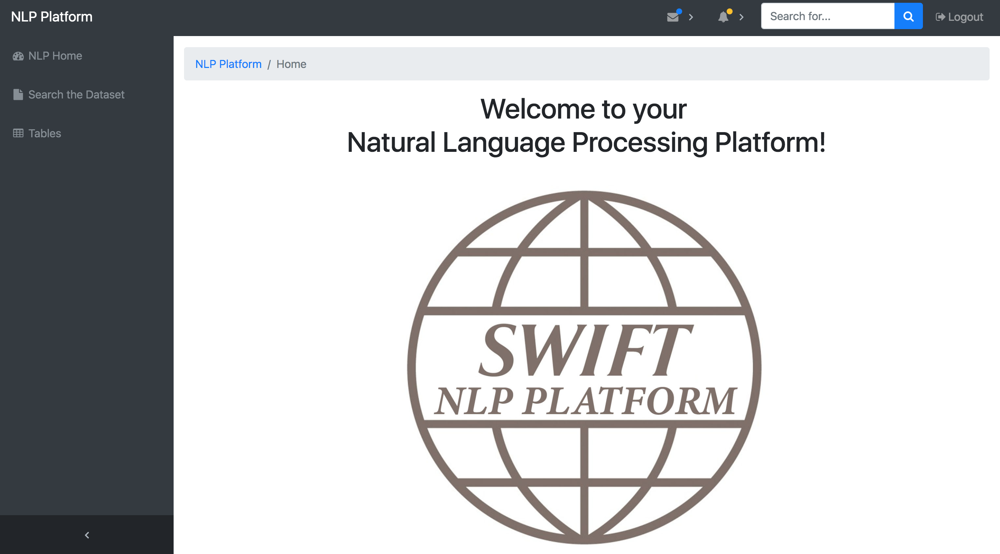

Slide 10
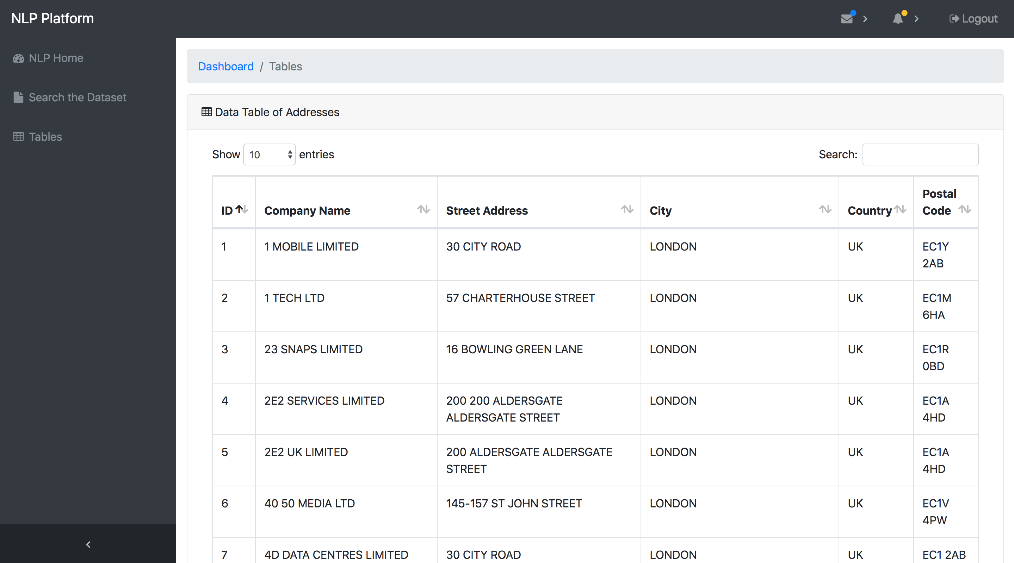

Slide 11
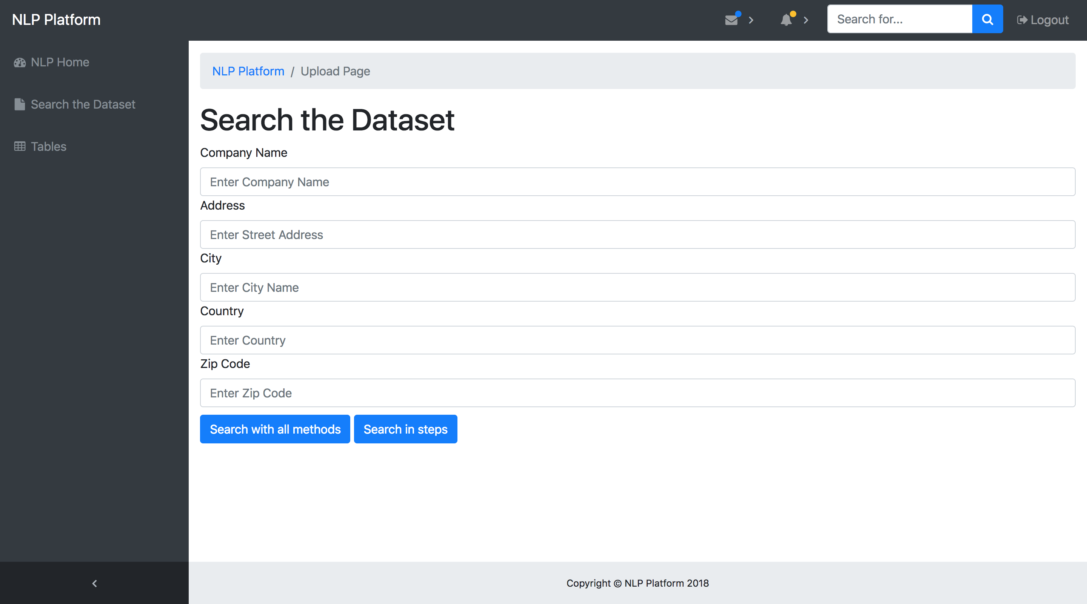

Slide 12


Slide 13
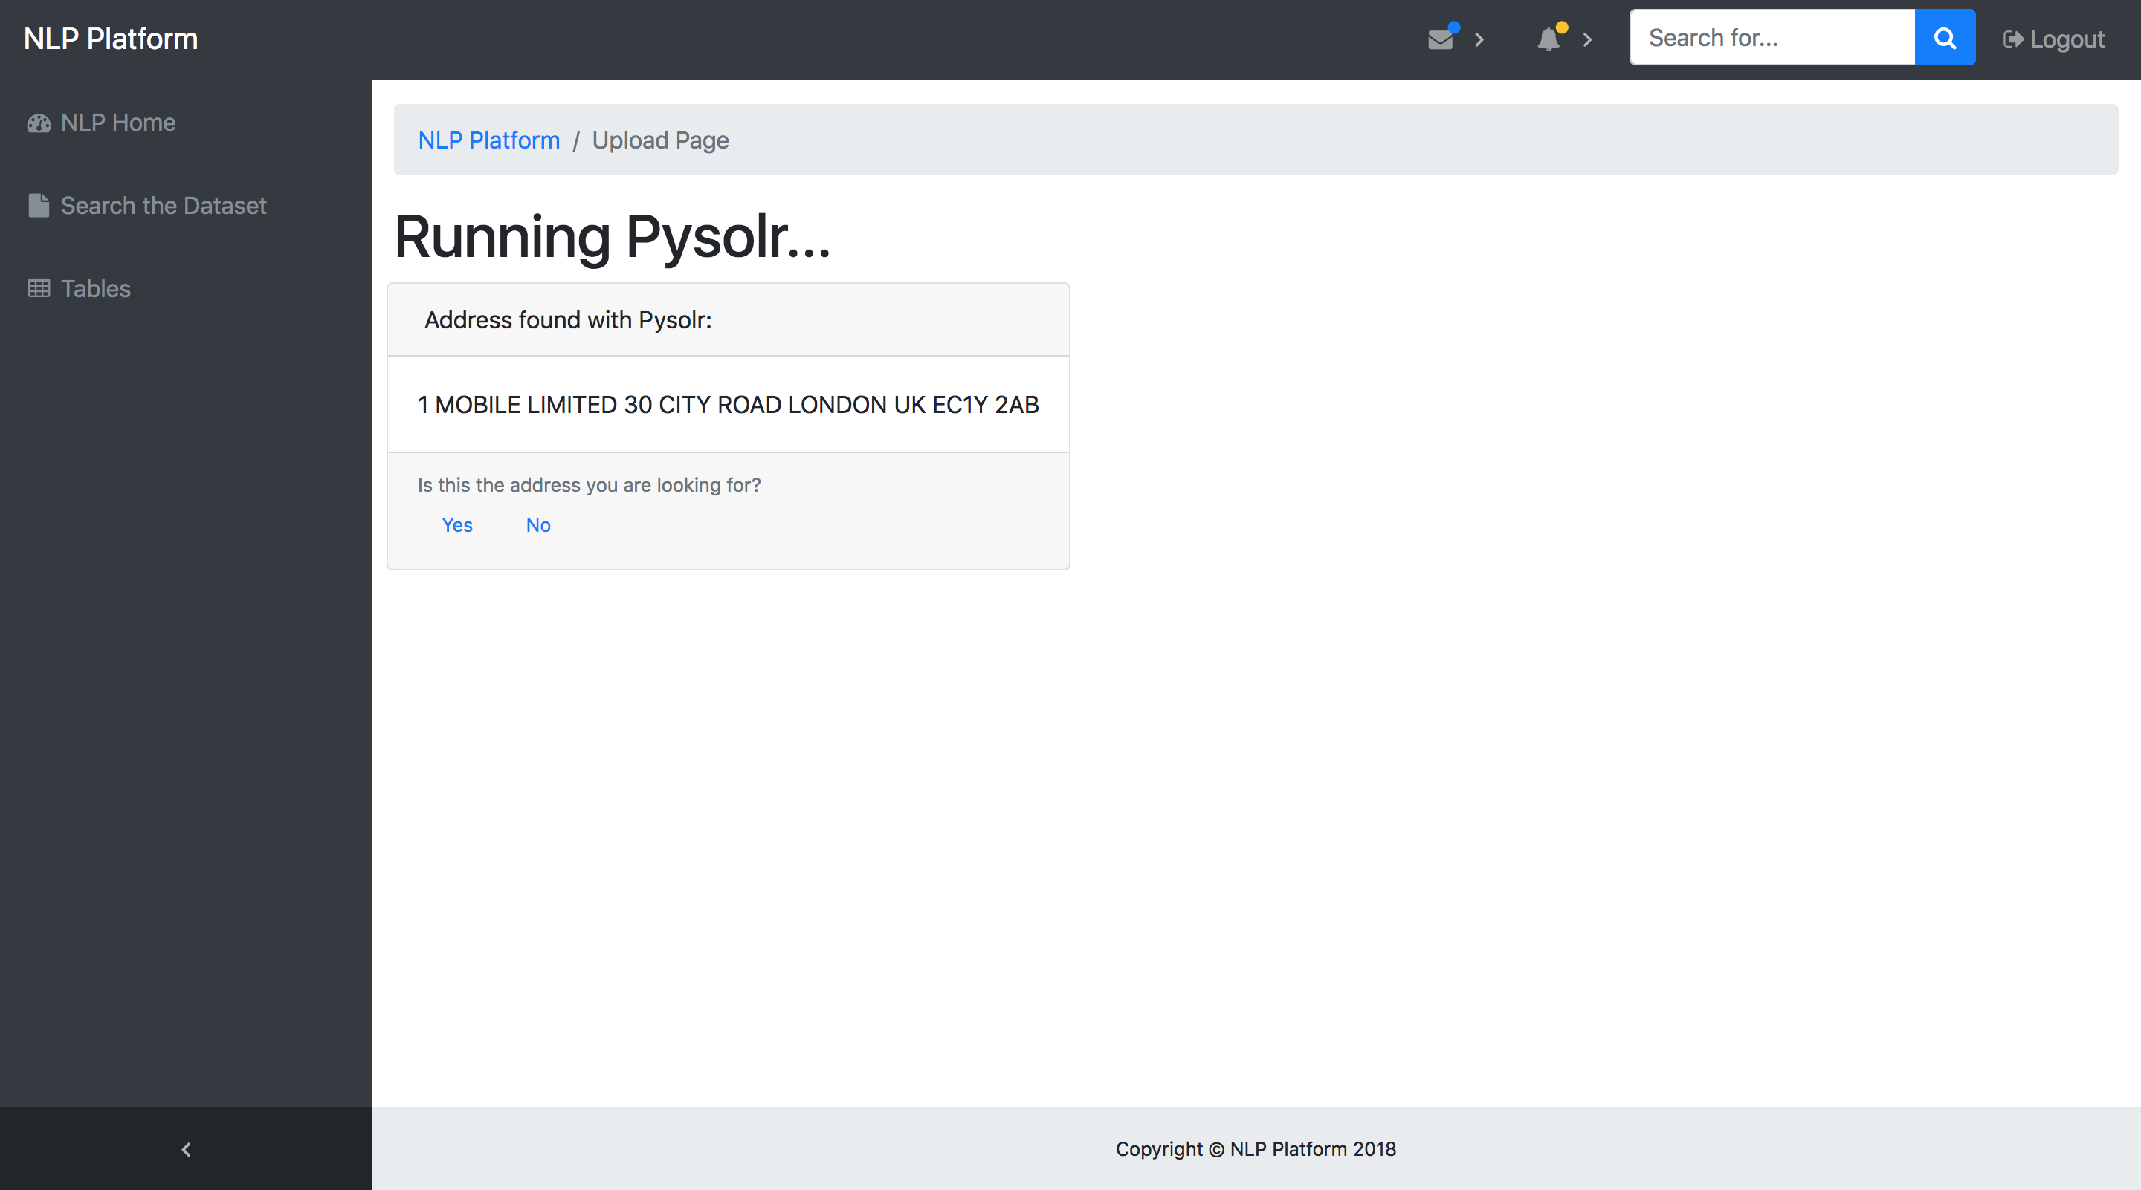

Slide 14
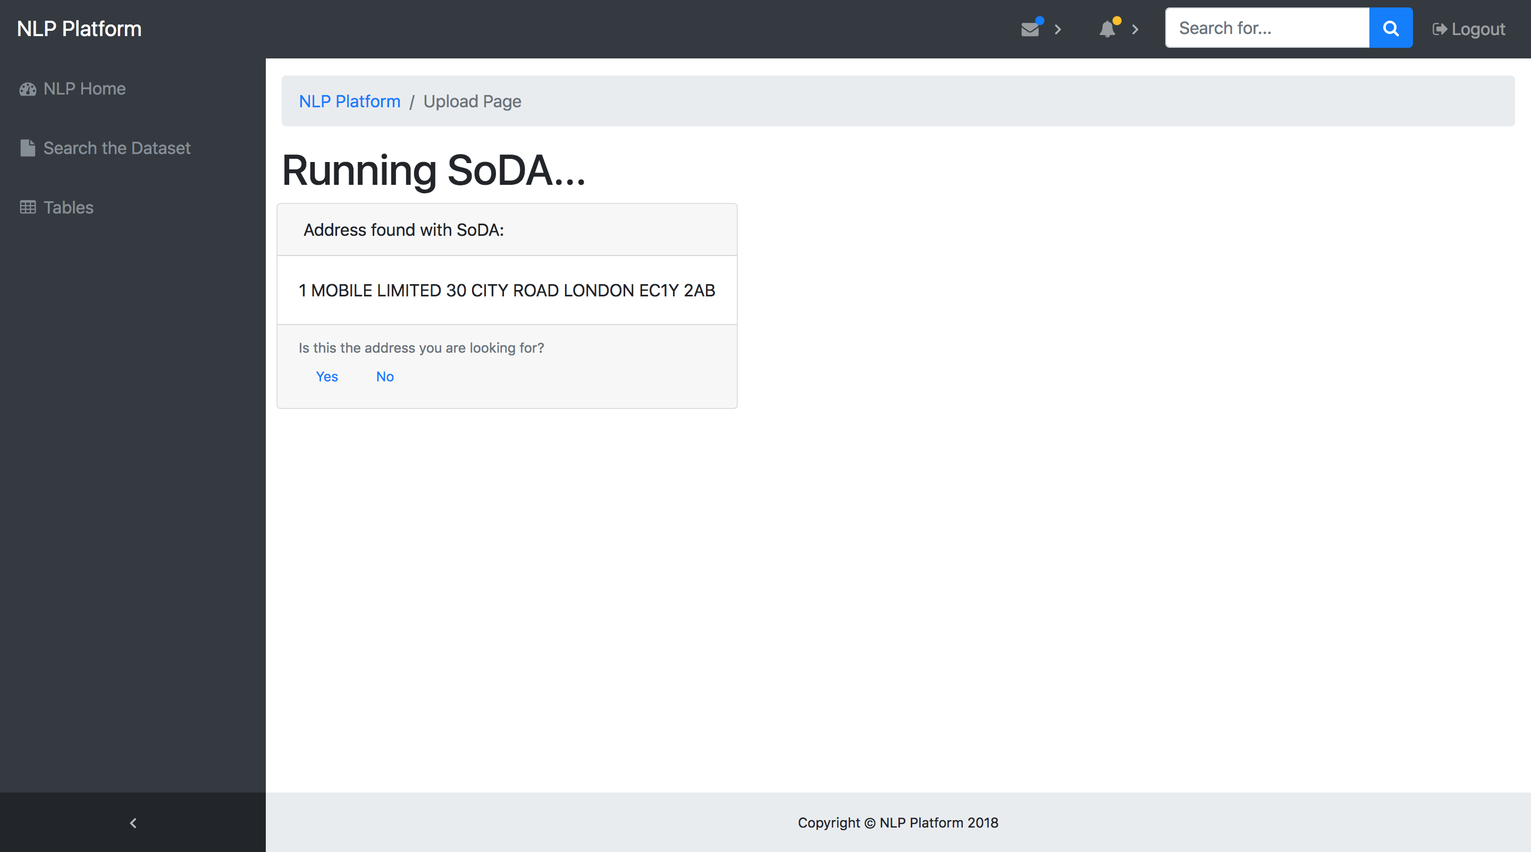

Slide 15
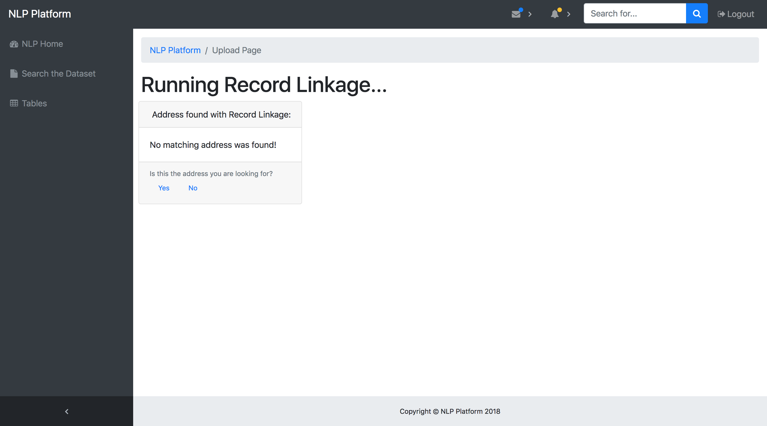

Slide 16


Slide 17
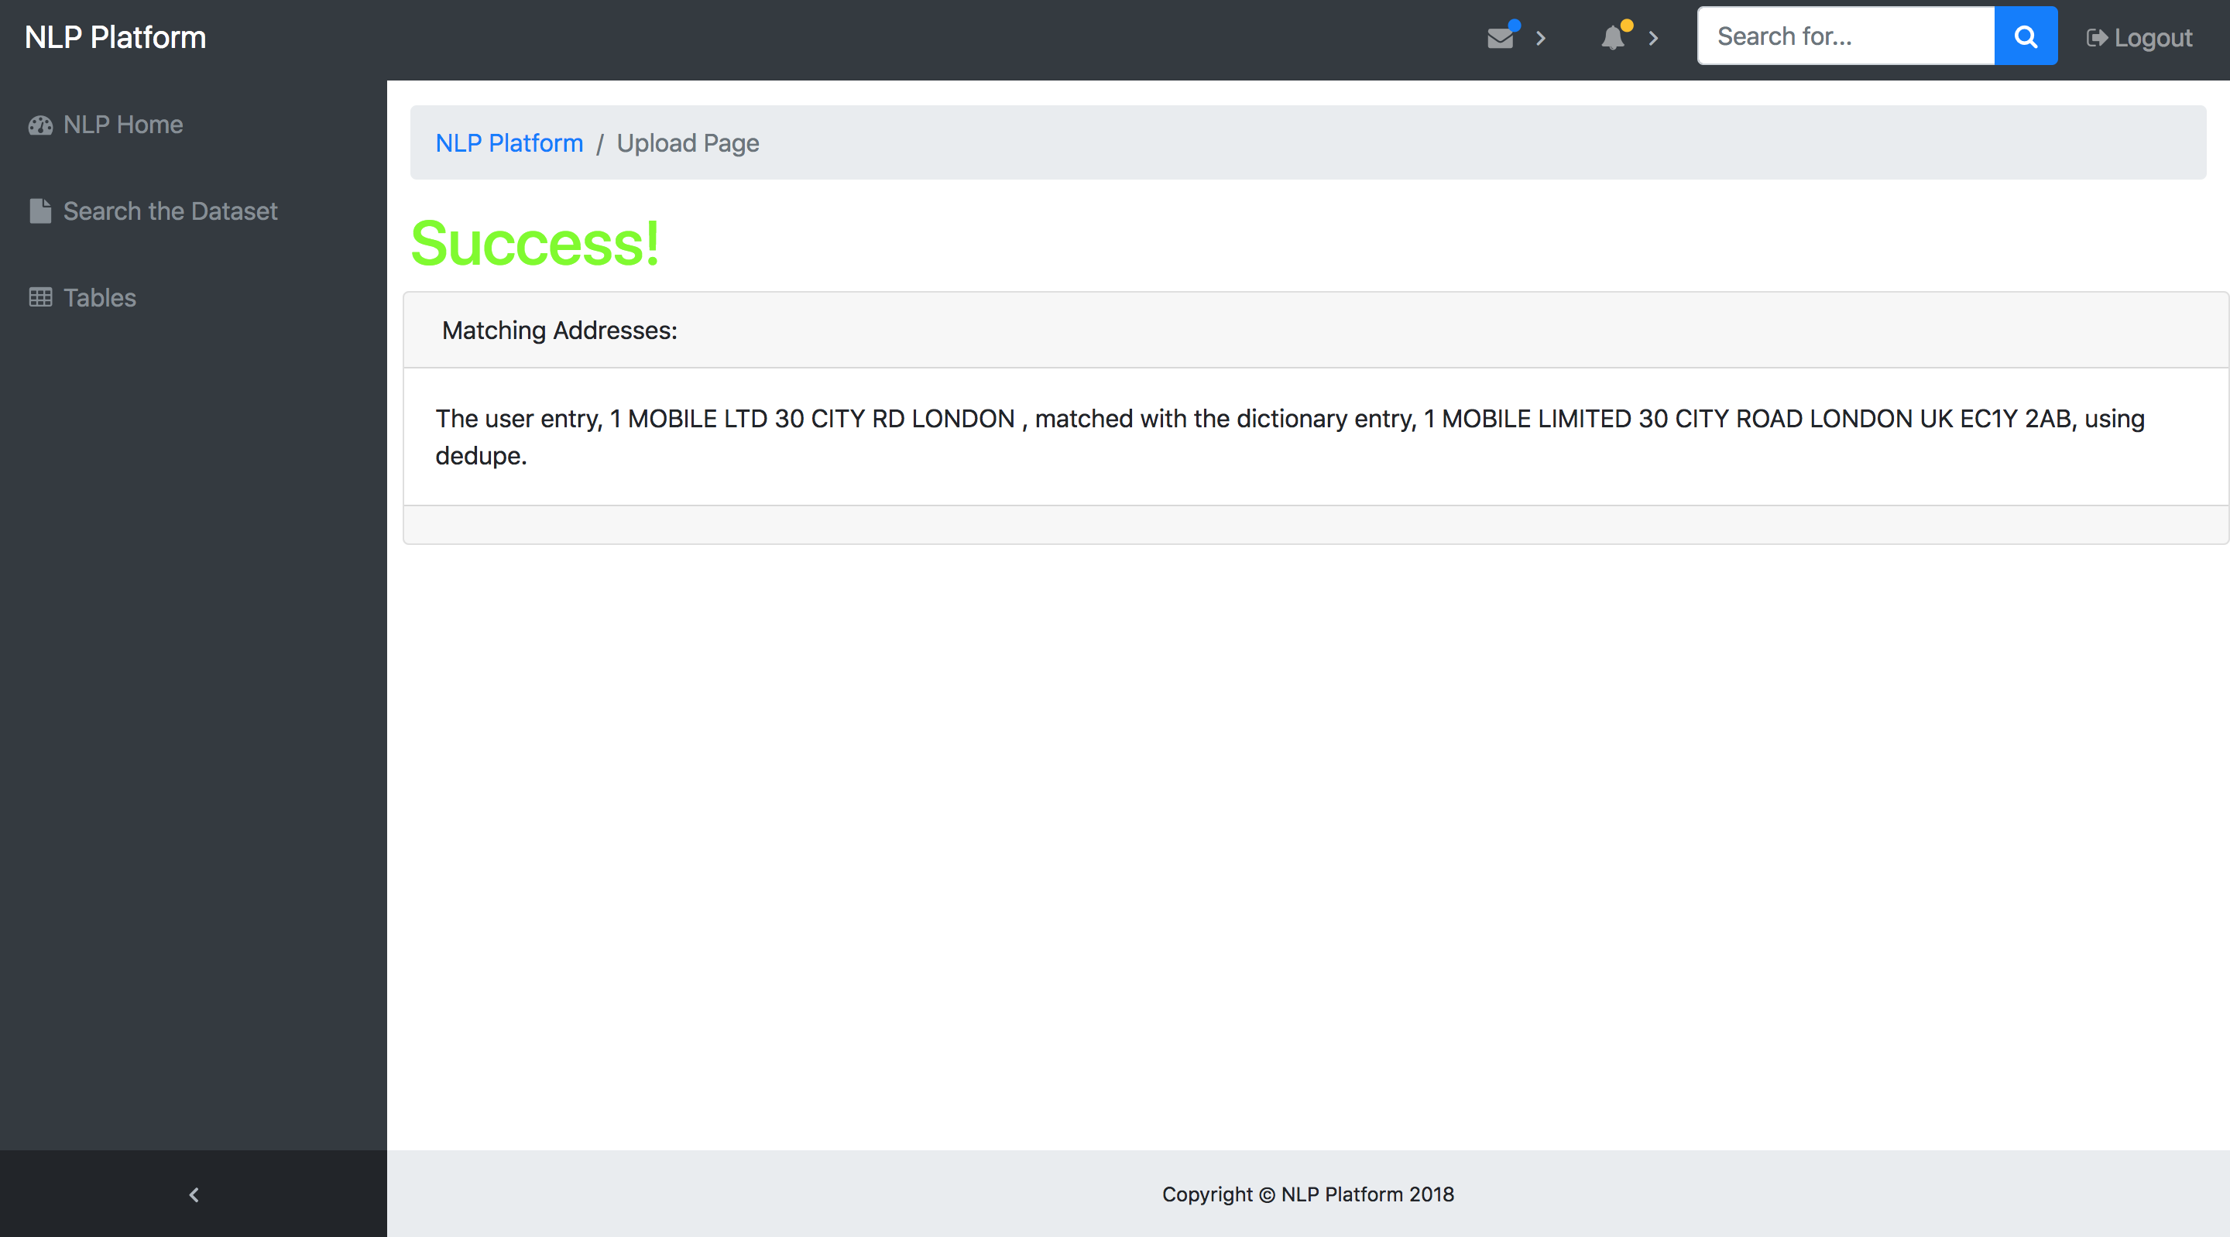

Slide 19


Slide 20
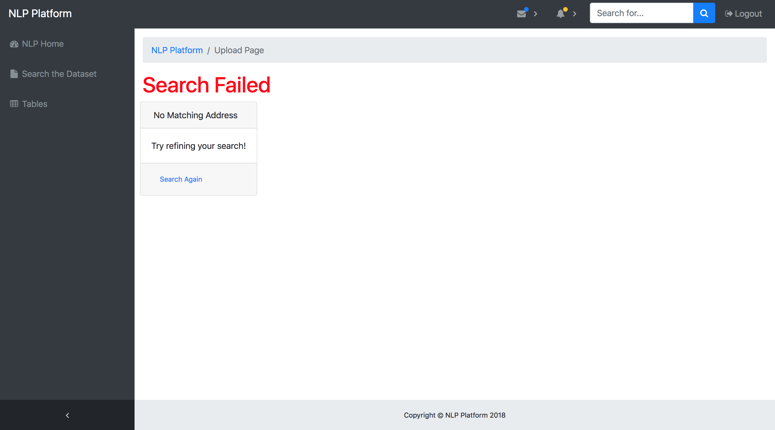

Slide 21
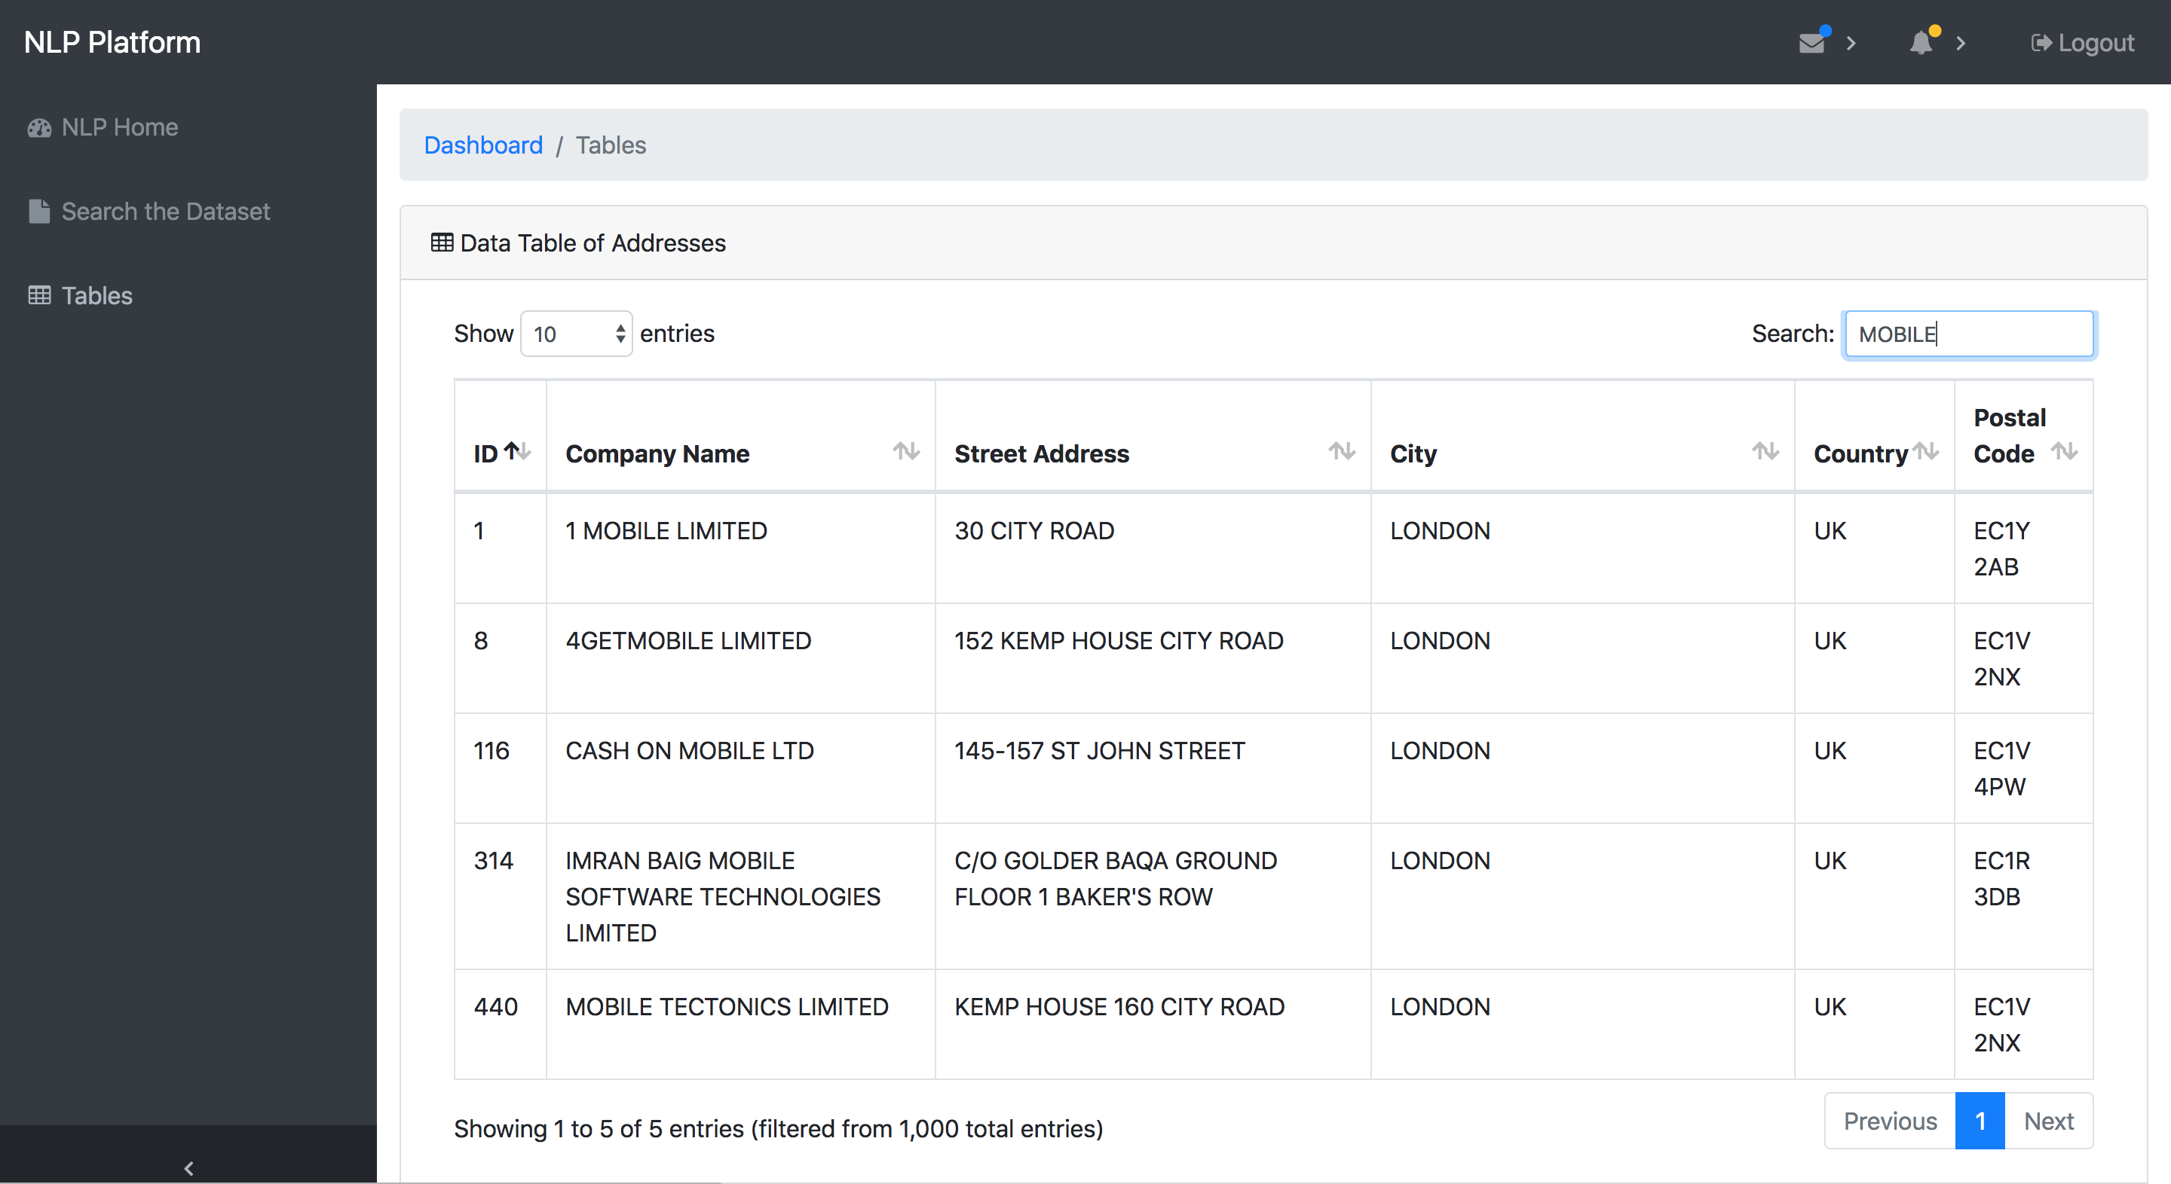

Slide 22
Entity Resolution Workflow
Preliminary
Look Up
ML Model
Output
Input

Slide 23
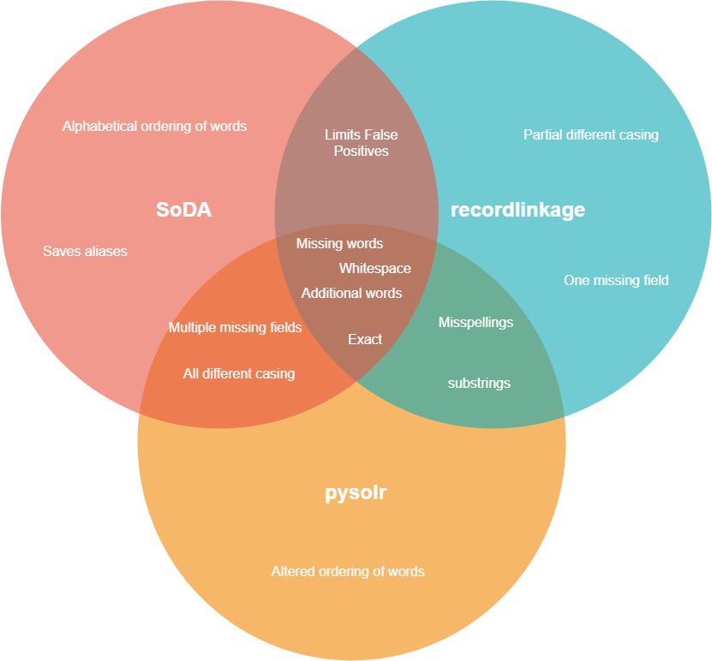
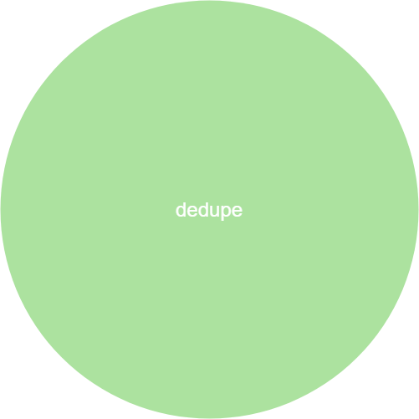
Matching Methods Machine Learning
Notes:
dedupe- not rule based, so it all depends on the data it is trained on

Slide 24
Demo Scenarios
Notes:
dedupe- thershold, false positives

Slide 25
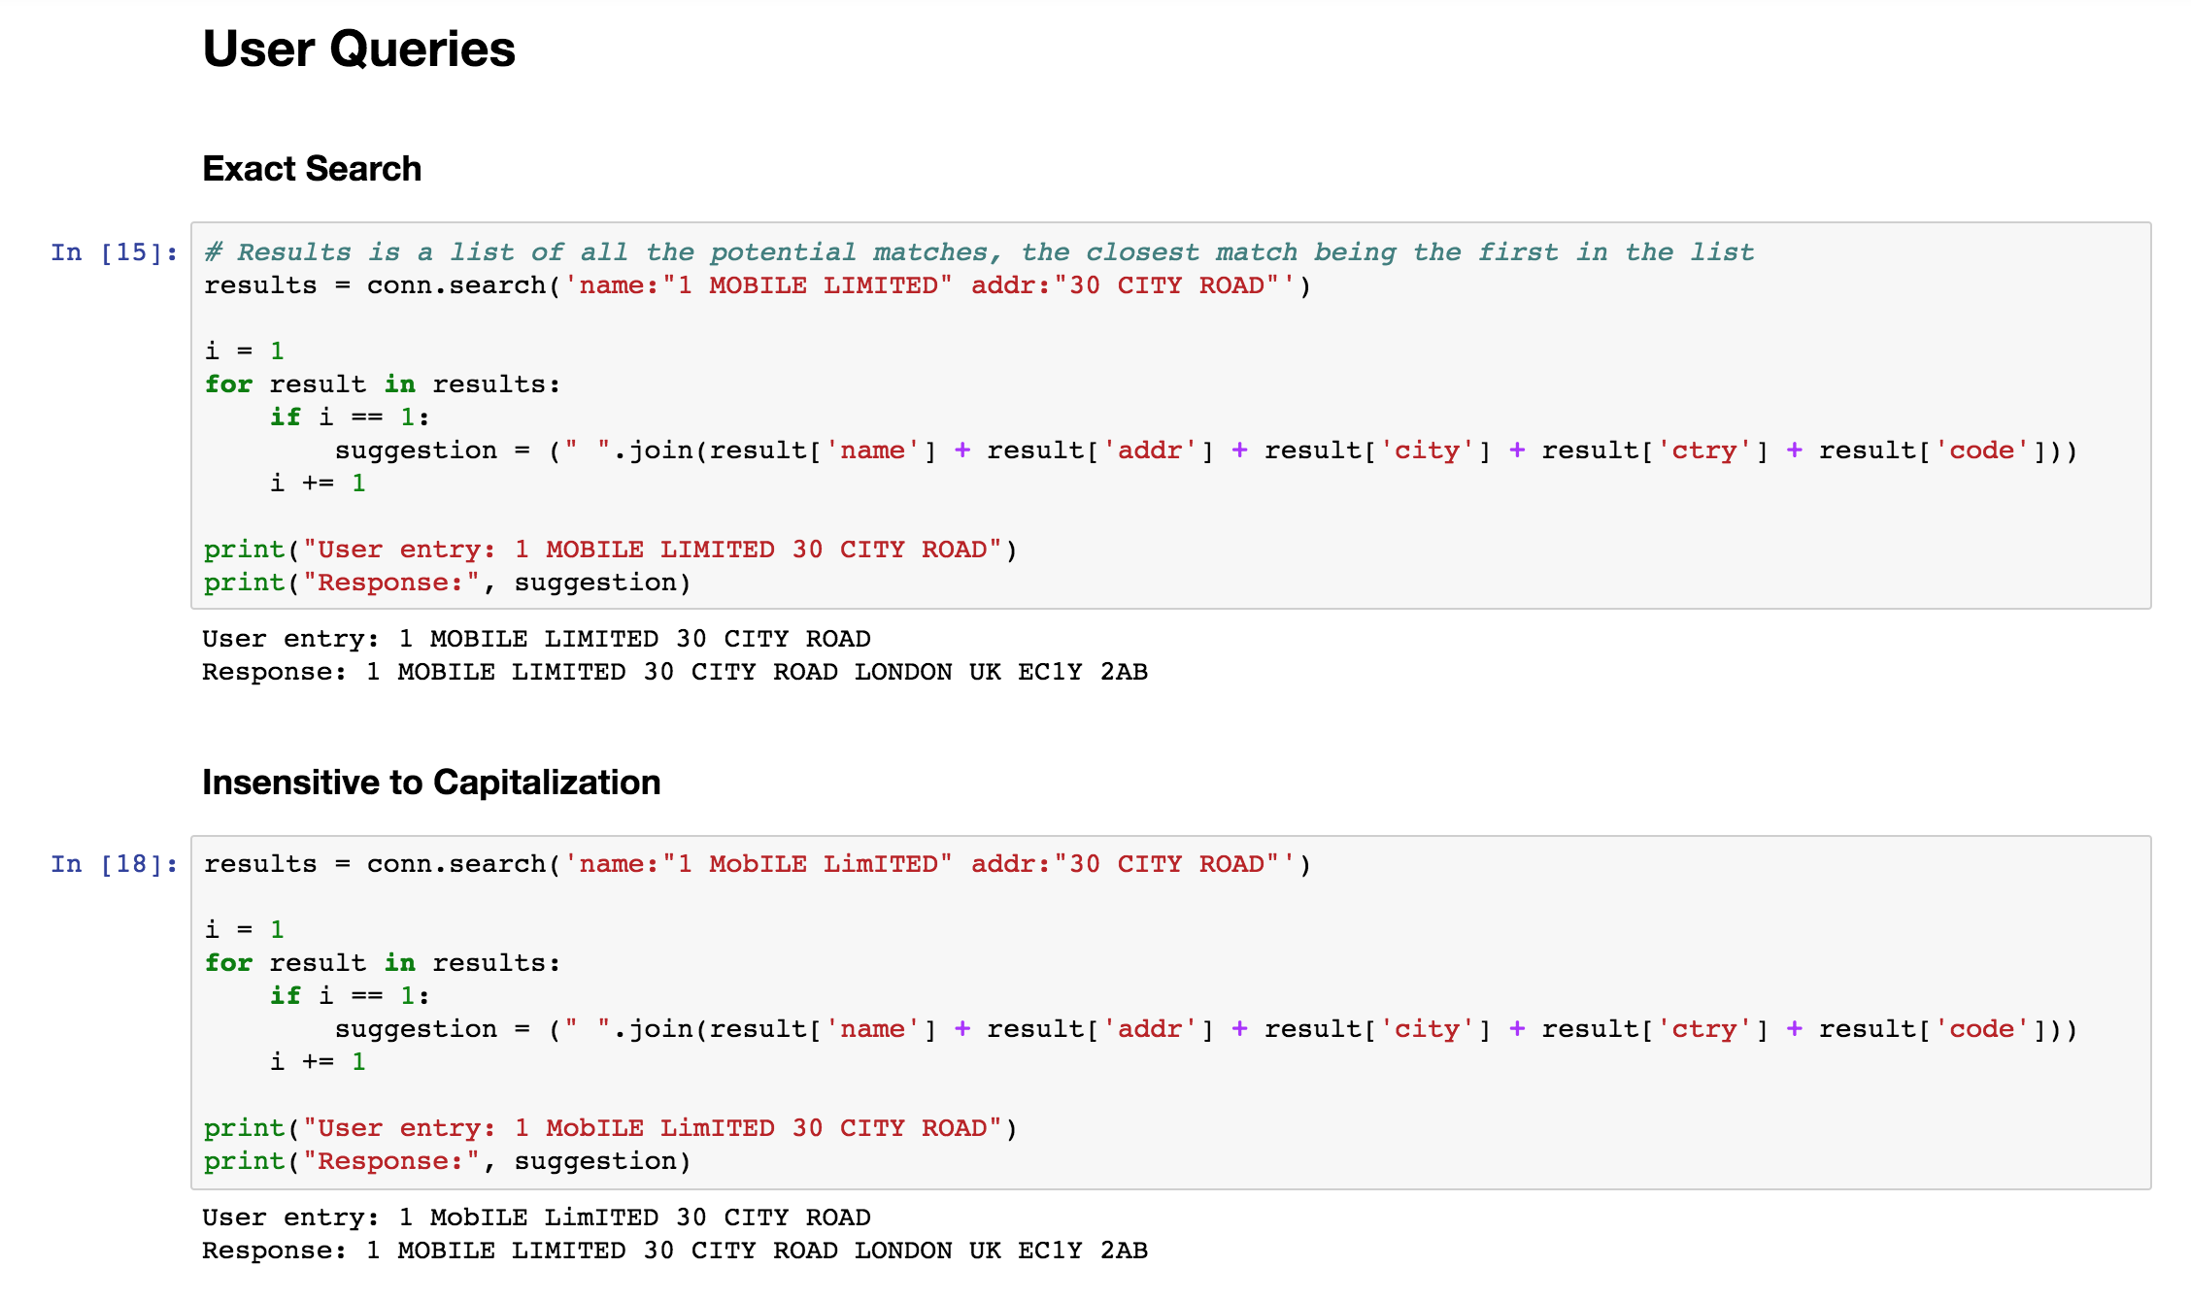
PySolr

Slide 26
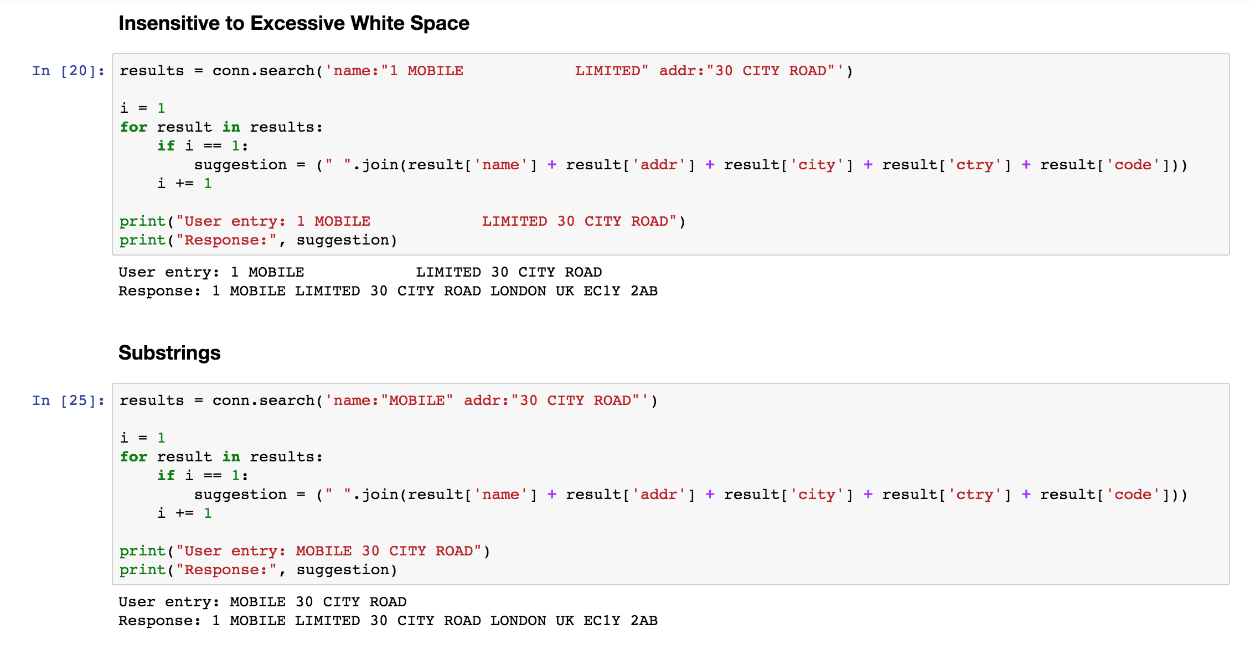
PySolr

Slide 27
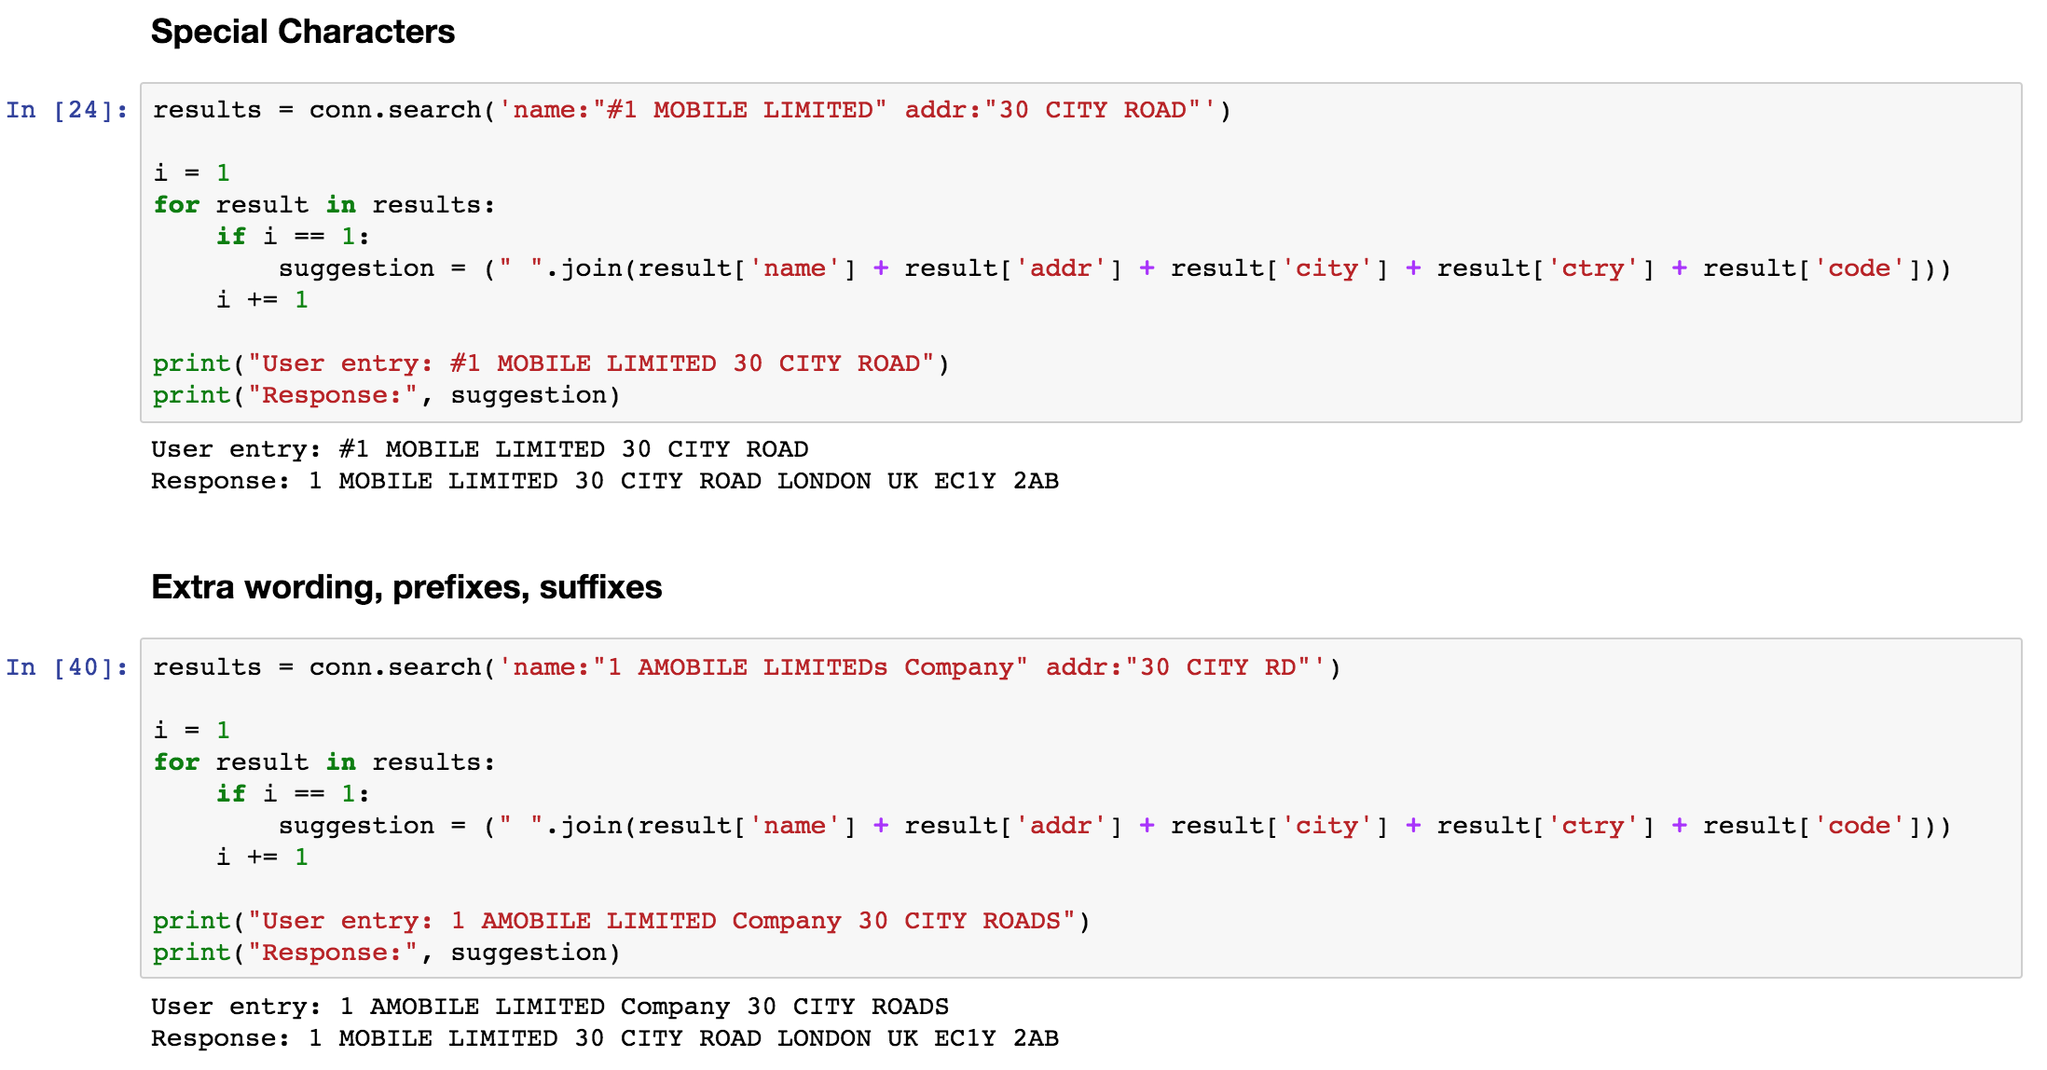
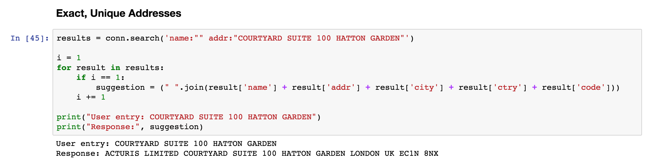
PySolr

Slide 28
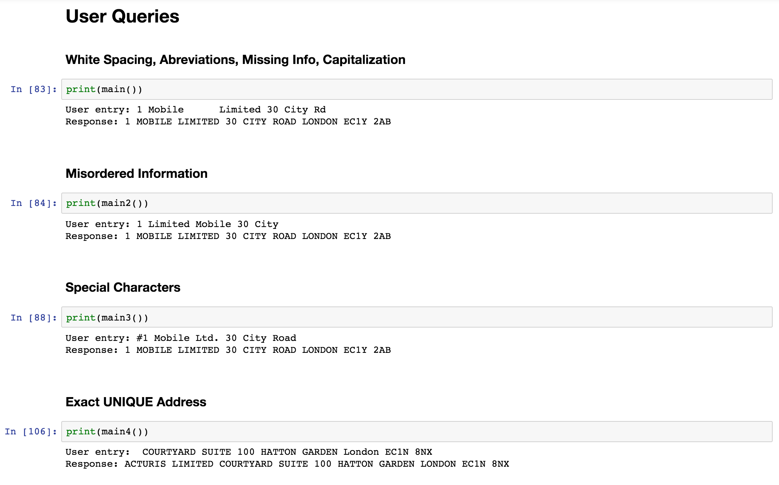
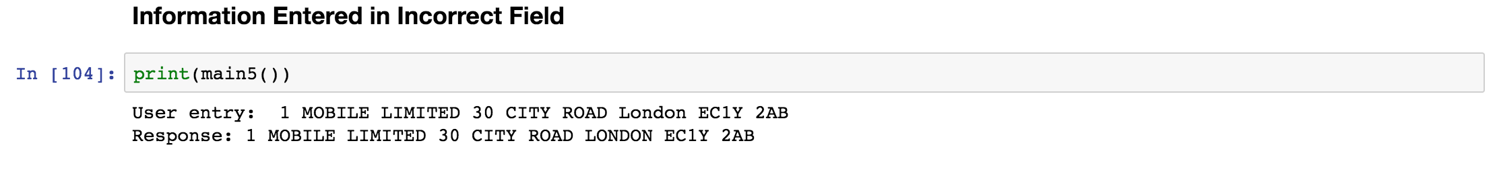
SoDA

Slide 29
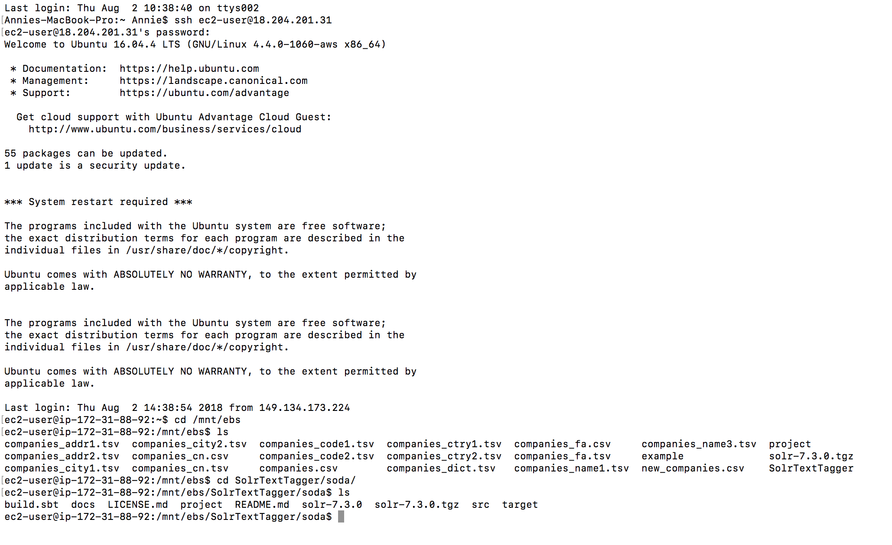
AWS SoDA Implementation

Slide 30
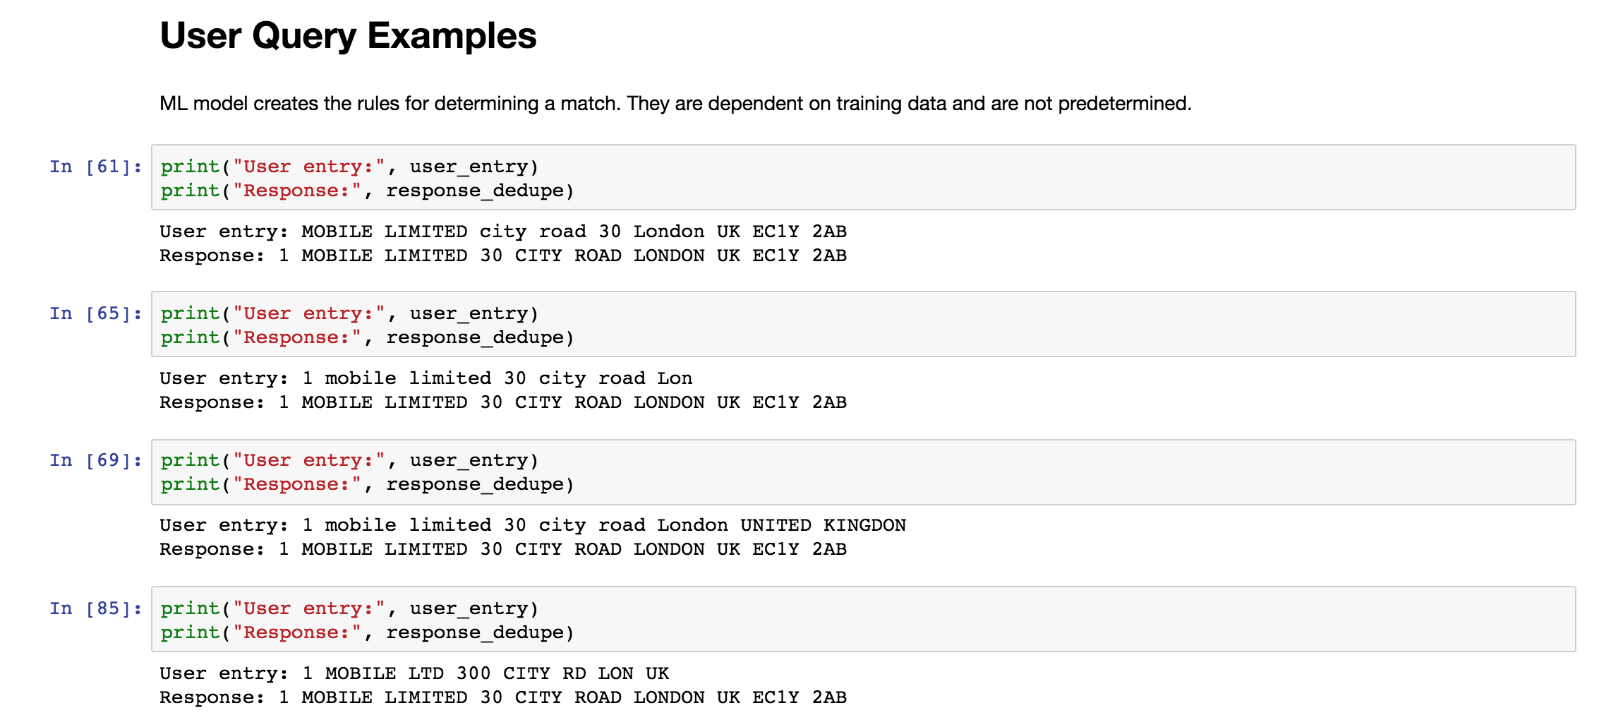
Dedupe

Slide 31
Conclusion and Future Work
SWIFT NLP Platform
Search / Lookup
Entity Resolution
Text Summarization
Document Classification
Speech to Text
e.g. Chatbot Questions
e.g. Customer Service

Slide 32
Questions?

